Slide 1

Project Title -Seasonal Agriculture Performance Analysis
Student Name : Shruti Mallikarjun Halle
College Name : SNDT Arts and Commerce College For Women Pune
AICTE STU ID : STU676d48447d8341735215172

Slide 2

PROBLEM STATEMENT
Agricultural activities are influenced by seasonal variations in environmental
conditions, farming practices, resource availability and market conditions. As
a result, agricultural performance may differ from one season to another.
Raw agricultural data does not, on its own, explain how performance changes
across seasons or what patterns exist within different seasonal conditions.
This project analyzes seasonal differences in agricultural performance by
identifying meaningful patterns, trends, relationships and variations across
Kharif, Rabi and Zaid seasons, and develops evidence-based recommendations.

Slide 3
Project Description
This project analyzes farm-level agricultural data covering environmental
conditions, farming practices, production, costs, revenue, profit and
resource usage across three seasons — Kharif, Rabi and Zaid.
The analysis includes data cleaning, univariate/bivariate/multivariate
exploration, correlation analysis, and statistical testing (Kruskal-Wallis)
to identify which differences across seasons are genuinely significant.
Key findings: Kharif consistently outperforms other seasons on yield,
profit and water efficiency, while Zaid is the only season with a negative
average profit. Farming inputs (fertilizer, pesticide, N/P/K) show almost
no correlation with yield, suggesting other unmeasured factors drive output.
The project concludes with season- and state-specific crop planning
recommendations.

Slide 4

WHO ARE THE END USERS?
- Farmers deciding which crops to grow in which season
- Agricultural extension officers and state agriculture departments
- Agri-business and supply chain planners forecasting seasonal output
- Researchers and policy makers studying seasonal agricultural trends

Slide 5

Technology Used
Python
Pandas, NumPy — data cleaning and analysis
Matplotlib, Seaborn — data visualization
SciPy — statistical testing (Kruskal-Wallis)
Google Colab / Jupyter Notebook

Slide 6
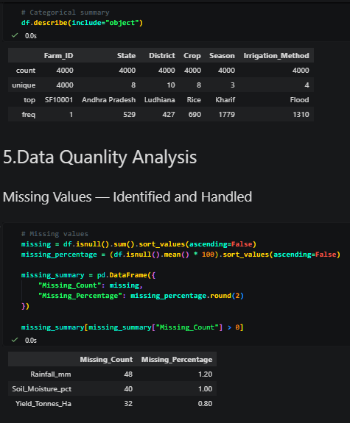
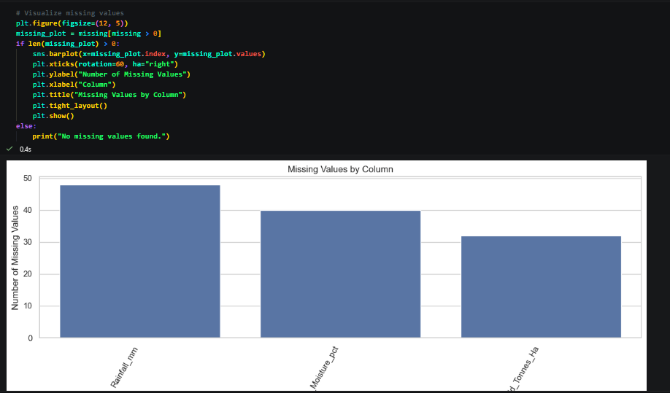
RESULTS
https://colab.research.google.com/drive/1lo5pqxsF_rp3-_T8csSqR9_USK77A6Cq?usp=sharing

Slide 7
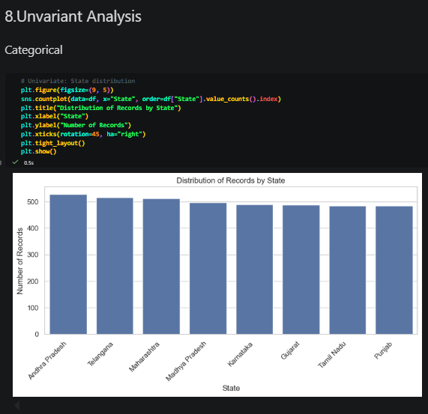
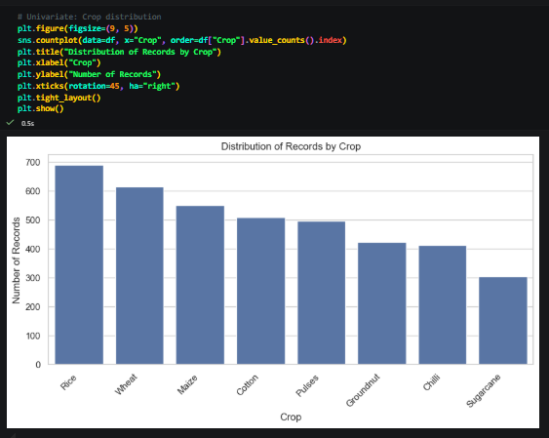
RESULTS
https://colab.research.google.com/drive/1lo5pqxsF_rp3-_T8csSqR9_USK77A6Cq?usp=sharing

Slide 8
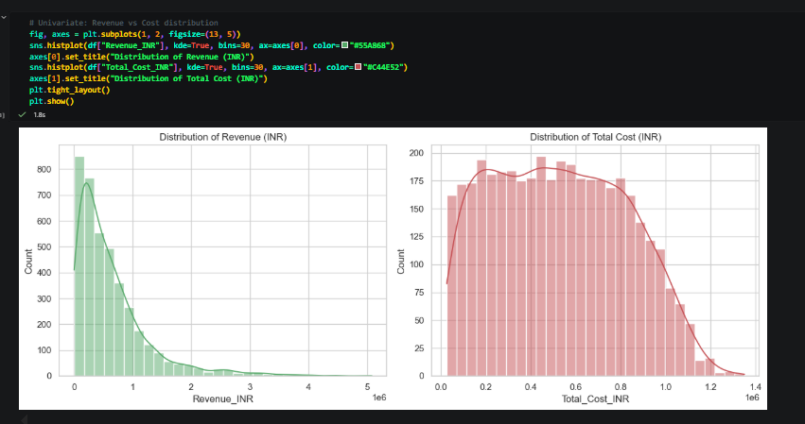
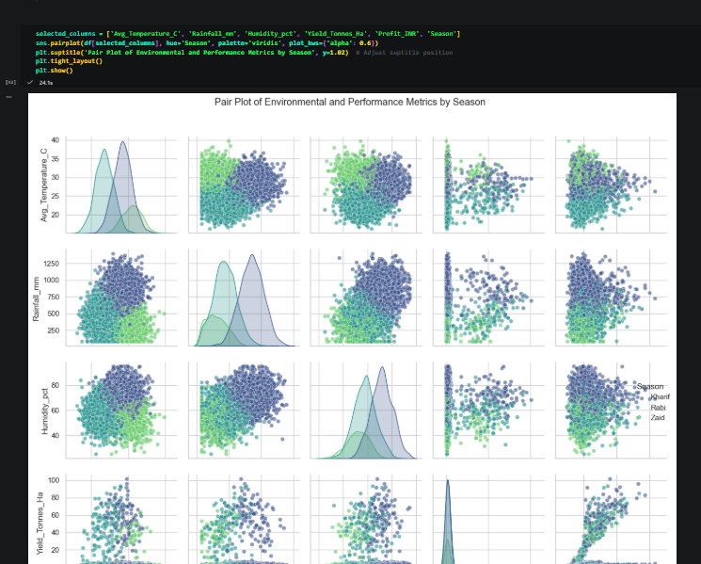
RESULTS

Slide 9
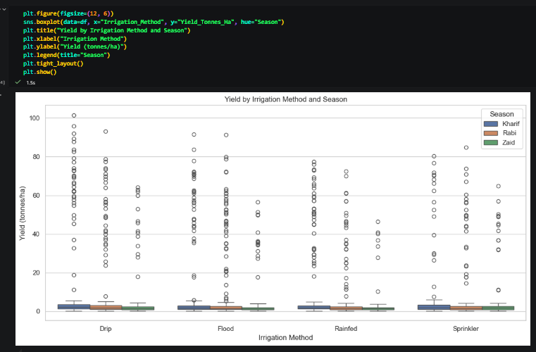
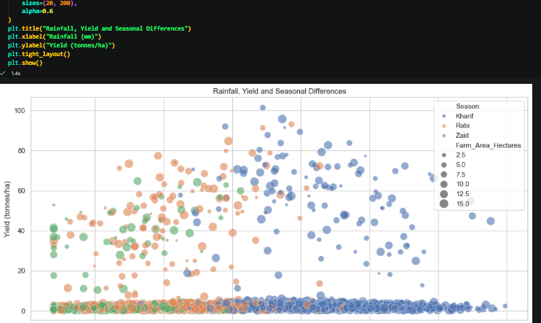
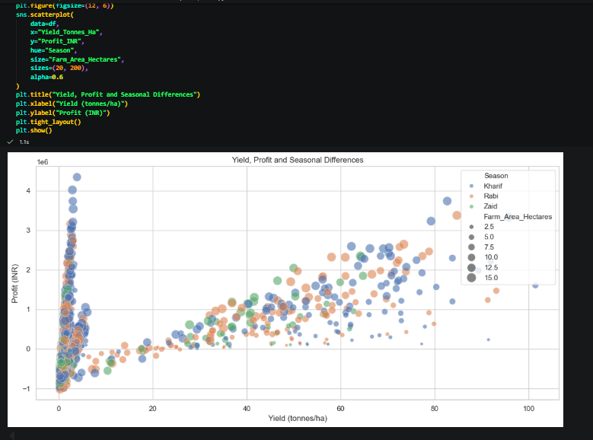
RESULTS

Slide 10
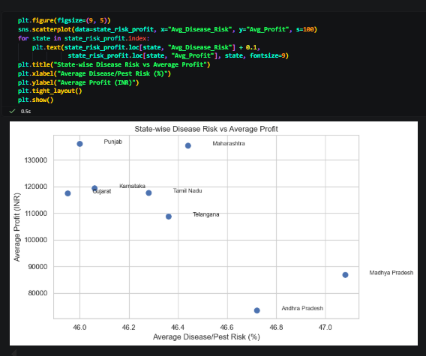
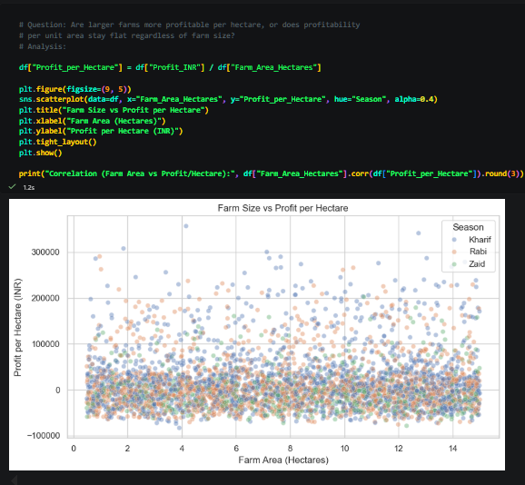
RESULTS

Slide 11
Future scope
- Incorporate multi-year data to test whether seasonal patterns hold
consistently over time, not just in a single snapshot
- Investigate additional variables (farming technique, seed variety,
labor practices) to explain the unexplained yield gap between seasons
- Build a lightweight dashboard for farmers to check season-crop
profitability recommendations for their state
- Extend the analysis to district-level granularity instead of state-level

Slide 12
GitHub Link
https://github.com/Shruti-Halle/Seasonal-Agriculture-Performance-Analysis

Slide 13
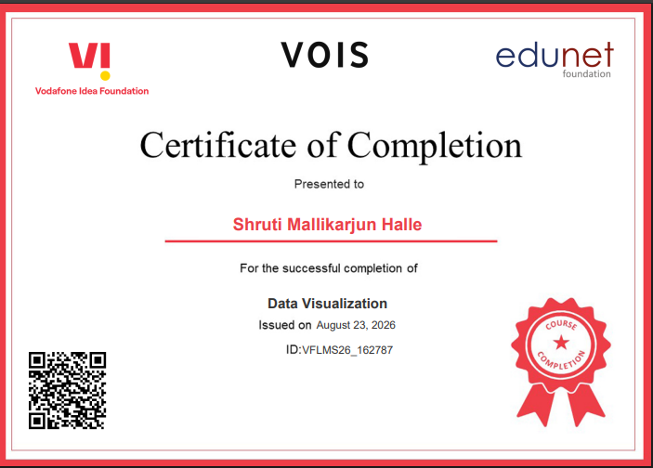
VOIS Course completion certificate - Course name- Data Visualization

Slide 14
Thank you
Shruti Halle | shrutihalle2@gmail.com
https://www.linkedin.com/in/shruti-halle/
https://github.com/Shruti-Halle/Seasonal-Agriculture-Performance-Analysis

